Slide 1
Class 2: Linear Programming
Michael Watson
Ehsan Khodabandeh

Slide 2
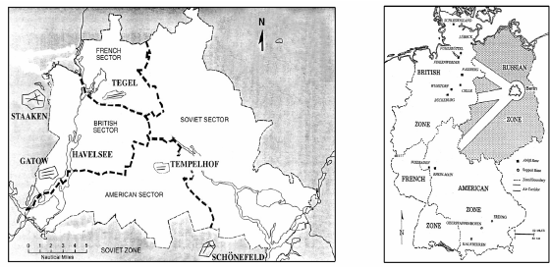
Berlin Airlift
In June 1948, the Soviet Union blocked all road, rail, and river traffic to and from West Berlin
A year-long airlift began
Sources: Robert Sedgewick and Kevin Wayne, Intro slides from Vladlen Koltun.
The Allocation of Resources by Linear Programming. Scientific American, R. Bland

Slide 3
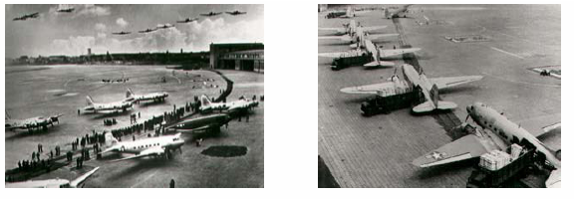
Berlin Airlift
225 Airplanes
277,804 Flights
2,325,809 tons of food and supplies
Planes departing every 3 minutes
Sources: Robert Sedgewick and Kevin Wayne, Intro slides from Vladlen Koltun.
The Allocation of Resources by Linear Programming. Scientific American, R. Bland

Slide 4
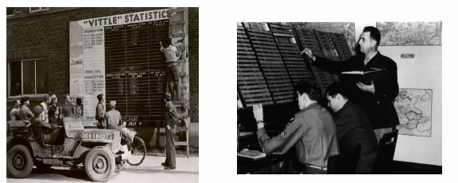

Berlin Airlift
Immense Logistics Challenges:
Scheduling of aircraft
Number of Planes and Crews
Packing goods on each plane
Sources: Robert Sedgewick and Kevin Wayne, Intro slides from Vladlen Koltun.
The Allocation of Resources by Linear Programming. Scientific American, R. Bland

Slide 5
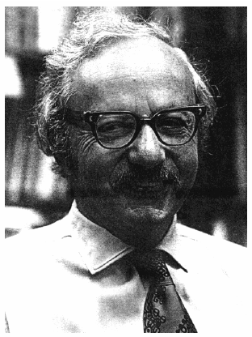
Berlin Airlift
George B. Dantzig:
Mathematical advisor at the defense department at the Pentagon
The “Berlin Airlift” linear program
One of the first LPs solved by hand using the simplex method
Sources: Robert Sedgewick and Kevin Wayne, Intro slides from Vladlen Koltun.
The Allocation of Resources by Linear Programming. Scientific American, R. Bland

Slide 6
Linear Programming: What is it?
Quintessential tool for optimal allocation of scarce resources, among a number of competing activities
Workhorse of prescriptive analytics: the output suggests a course of action
Powerful and general problem-solving method (applies to lots of problems and if you can formulate it as a linear program, you can solve it)
Note on the term “programming”
When the term “linear programming” was coined, the term “programming” referred to planning or scheduling within a large organization
Has nothing to do with what we now call computer programming

Slide 7
Linear Programming: Why Significant?
Forms the basis of Integer, Non-Linear Programming, and Heuristics
Fast commercial solvers
Powerful modeling languages
Widely applicable to industry
When someone mentions “optimizing” a process, chances are they are referring to LP
Embedded in many types of applications
Probably used somewhere in the companies you are associated with
One of the most important mathematical techniques of the 20th century
Nobel Prize in Economics in 1975

Slide 8

Part of Quantitative Tool-Kit
“The B-school education that emerged after the war was hugely different. Business was adopting new quantitative tools– including cost-accounting systems and linear programming– that had come out of the military”
Nov 5, 2007; page 90.

Slide 9

The Decade of the 70’s
Interest in optimization flowered
Success stories from the war led to a lot of research
Numerous new applications identified
Large scale planning applications particularly popular
Funding widely available
Significant difficulties emerged
Building applications was very expensive and very risky
3-4 year development cycles
Developers and application owners had to be multi-faceted experts: Computer, Data, Algorithm, and Modeling skills necessary.
“Deploying an application was virtually impossible”
Technology just wasn’t ready: LPs were hard and MIP was a disaster
Result: Losing faith in the technology and some of that persists to this day.
Notes:
8

Slide 10

The Decade of the 80’s
Mid 80’s:
There was perception was that LP software had progressed about as far as it could (like Deep Learning at some points)
But, there were several key positive developments
IBM PC introduced in 1981
Brought personal computing to business
Relational databases developed: Separation of logical and physical allocation of data. ERP systems introduced.
Notes:
Dean of Engineering in Tel-Aviv University 1985: Forget about OR, it’s a dead field
9

Slide 11

The Decade of the 90’s
LP performance takes off
LP software becomes embeddable and flexible
Algorithms
Primal-dual log-barrier algorithms completely reset the bar
Simplex algorithms unexpectedly keep pace
Dual steepest-edge emerged as the winning simplex algorithm
Data became plentiful and accessible
ERP systems became commonplace
Popular new applications begin to show that Optimization can work on difficult, real problems
Business: Airlines, Supply-Chain
Academic: Traveling Salesman Problem
Notes:
10

Slide 12

LP Progress 1988 - 2004
(Operations Research, Jan 2002, pp. 3—15, updated in 2004)
Algorithms (machine independent):
Primal versus best of Primal/Dual/Barrier 3,300x
Machines (workstations →PCs): 1,600x
NET: Algorithm × Machine 5,300,000x
(2 months/5300000 ~= 1 second)
More than Moore

Slide 13
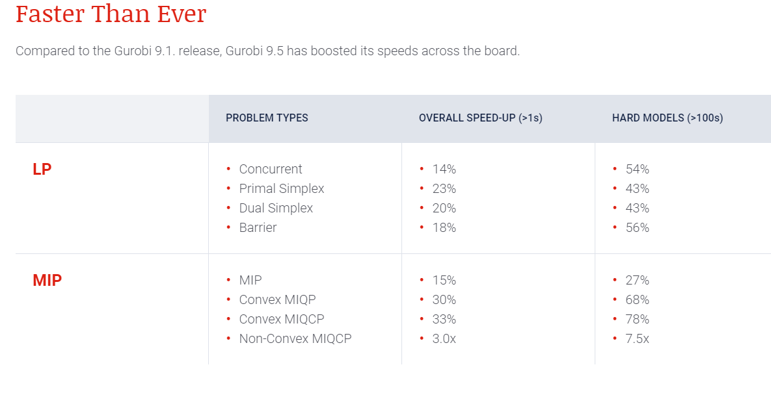

LP Progress– Still Going in 2022
Gurobi solver speed-ups reported on their website as of 9/13/2022

Slide 14
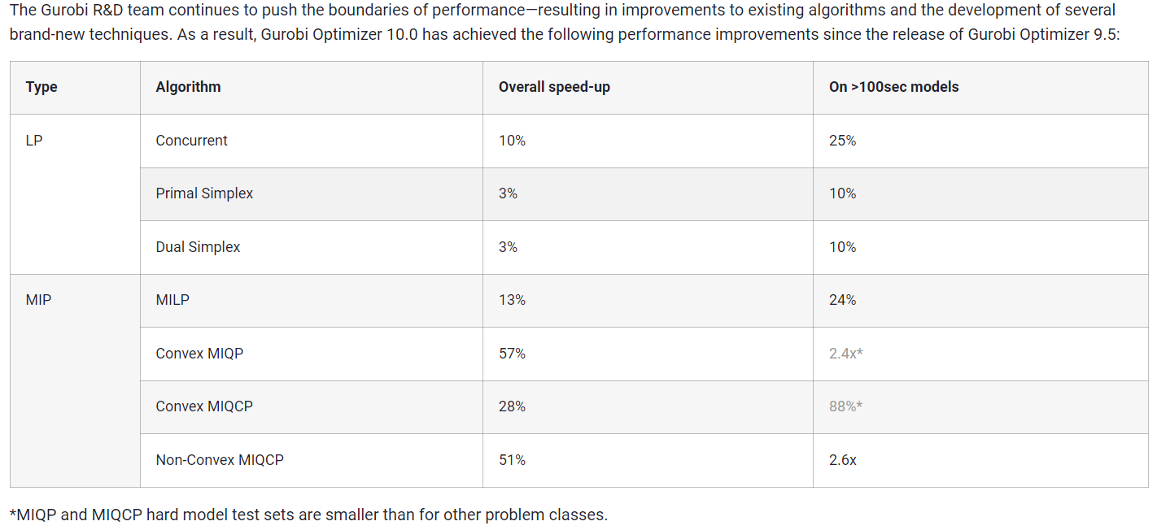
LP Progress– and continues…
Gurobi solver speed-ups reported on their website as of 9/5/23 from a 11/14/2022 press release
Decades of solver speed-ups have been an engineering feat, like what we are seeing with Deep Learning and NLP. Note– open source solvers are about 6-10X slower and not as robust

Slide 15
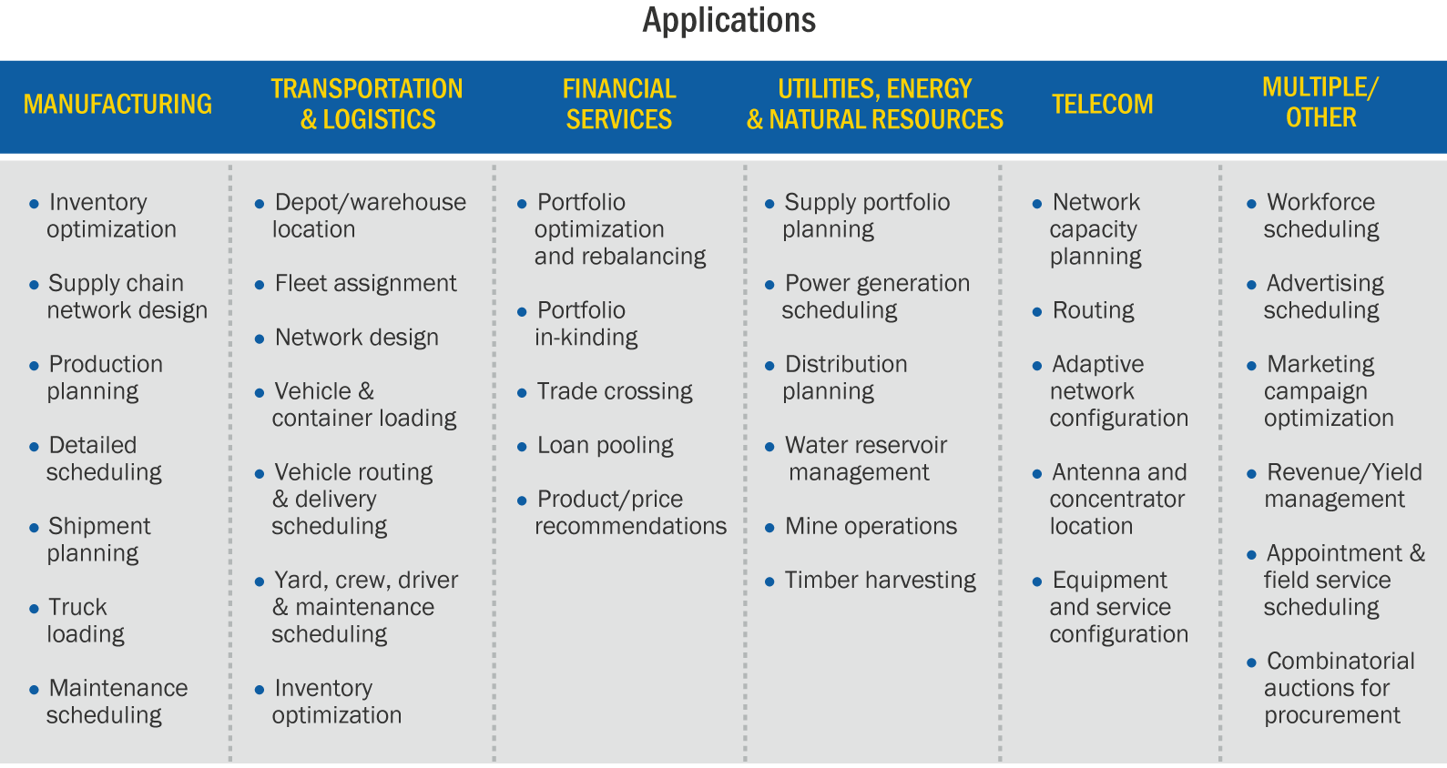
Today… Used Everywhere
Source: IBM

Slide 16

Linear Programming is Effective
Documented ROI of INFORMS Edelman Award Finalists
INDEVAL | Securities clearing in Mexico | Clears $250B daily, continuously saving $240M in inter-day interest costs. Dramatically improved liquidity of market
South African Defense | Force/Equip Planning | $1.1 bil/year
Motorola | Procurement Mgmnt | $100-150 mil/year
Samsung Electronics | Production Scheduling | 50% reduction in cycle time
2 Chilean Forestry firms | Timber Harvesting | $20 mil/yr + 30% fewer trucks
UPS | Air Network Design | $87m/2yrs + 10% fewer planes
SNCF (French RR) | Scheduling & Pricing | $16m/yr rev + 2% lower op ex
Continental Airlines | Crew Re-scheduling | $40 mil in one year
AT&T | Network Recovery | 35% reduction spare capacity
Grant Mayo van Otterloo | Portfolio Optimization | $4 mil/year
$336 billion in value since prize inception

Slide 17

Let’s Take a Break: Reminder of where we are going…
What we’ll do…
What we won’t do
Spend too much time with the theory
Dive too deep into any one problem
Replace a Masters Degree in optimization with this course
Help you understand the practice of optimization
Provide you with hands-on exercises
Show you a lot of different types of problems and applications

Slide 18


Linear Programming (and Optimization Defined)
Optimization
Narrowing your choices to the very best when there are virtually innumerable feasible options and comparing them is difficult

Slide 19
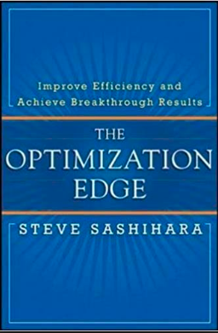
Linear Programming (and Optimization Defined)
Optimization
“makes explicit recommendations to help you achieve your goals. Optimization… juggle(s) and evaluate(s) millions or tens of millions of choices before presenting what they recommend as the optimal, or best, choices.”

Slide 20
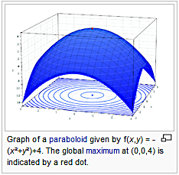

Linear Programming (and Optimization Defined)
Wikipedia Gets Technical Fast…

Slide 21
Linear Programming (and Optimization Defined)
We’ll come back to these definitions later…
… I’m not that happy with any of them

Slide 22
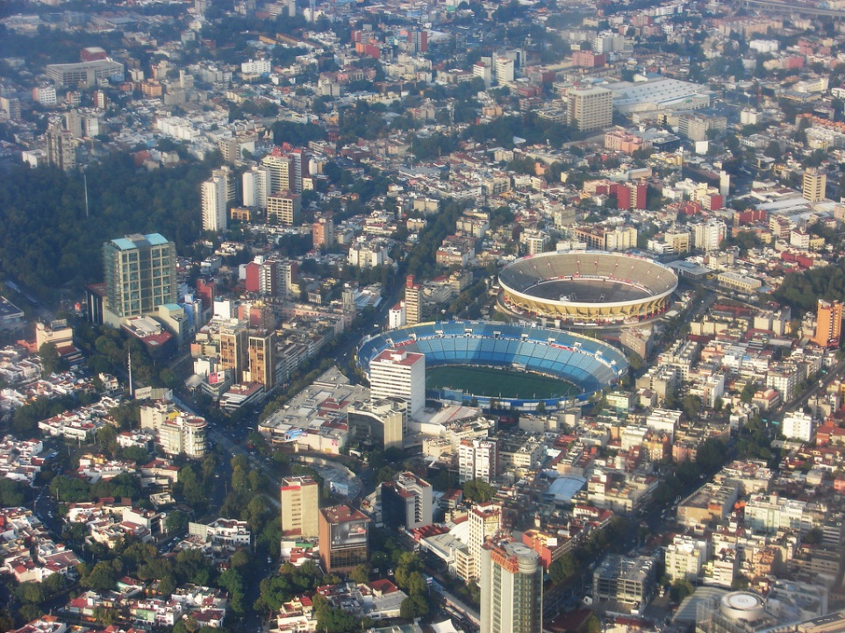

In Business, to run optimization, you need a model
Modeling is about taking the real world…
… and abstracting just the features that
matter to solve your problem
Picture of Mexico City from Wiki Commons by George Miquilena

Slide 23
In Business, to run optimization, you need a model
Modeling is about taking the real world…
… and abstracting just the features that
matter to solve your problem
Modeling is the art and science of creating good and useful models
Picture of Mexico City from Wiki Commons by George Miquilena

Slide 24

In Business, to run optimization, you need a model
Only as complicated as needed to answer the question, and no more

Slide 25
In Business, to run optimization, you need a model
Only as complicated as needed to answer the question, and no more
What if we wanted a model to estimate the power of a potential dam?
Our model would have information on:
The flow and volume of the river
The height of the dam
The model would not need information on
How thick the foundation needed to be
Whether it should also act as a bridge or not

Slide 26
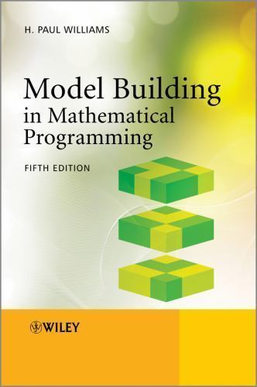
A Good Book on Models in an Organization
Serious Play
By Michael Schrage
“…constructing a mathematical model of an organization provides one the best methods of understanding that organization.
…the process of building a model of an organization can often be more beneficial even than the obtaining of a solution.”
You can find a link to my write-up on Serious Play in this list (click on the book title). https://miketalksai.substack.com/p/the-45-business-books-that-i-recommend

Slide 27

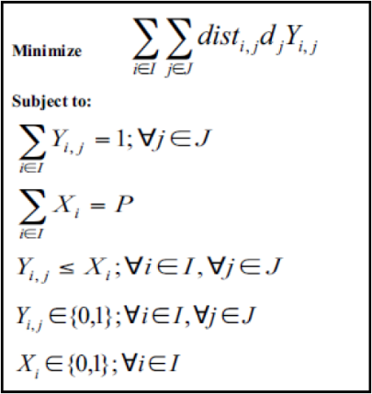
How Do you Create a Linear Programming Optimization Model?
Take your real business problems and challenges….
…and break down your problem so you can model it…
…and use this to create a set of equations that become your model
Objective
Decisions
Constraints

Slide 28
Worth Repeating: The Components of an Optimization Problem
What makes one choice better than another? What target should be used to compare one set of choices to another? What is the objective?
Objectives can be costs, revenue, profit, service, others…
What resources need to managed? How are they limited? What are the constraints?
What choices need to be in order to manage these resources? What are the decision variables?
Source: IBM

Slide 29
Notes About Linear Programs
Have to be linear
Objective function and constraints must be written as linear equations
You can’t multiply decision variables together
You can’t divide by decision variables
You can’t use if-statements. (I’m going to have you get started in Excel to build intuition– you really don’t want to use any formula in Excel except adding and multiplying by constants.)
The “linear” assumption seems to be limited
Let’s make sure we can do this before we try to tackle this assumption!
Note: We can solve these problems! Two choices:
Choice One: You might have to make some assumptions or create work-arounds because of linear assumptions, but you get a reliable answer
Choice Two: You don’t use limiting linear assumptions, but you don’t have a way to solve the problem
I think you’ll find: the linear assumptions aren’t so bad!

Slide 30
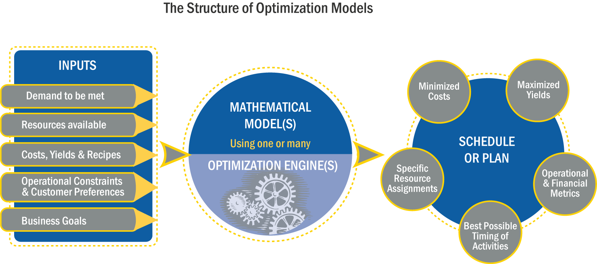
How does Optimization Work?

Slide 31
Linear Programming Basics: Example of a Small Brewery
Profit per barrel of Beer:
Profit per barrel of Ale:
Decision:
Potential limits on production:
$23
$13
How much Beer and Ale do you make?
Capacity (time)
Raw Materials
Labor
Demand
Other??

Slide 32
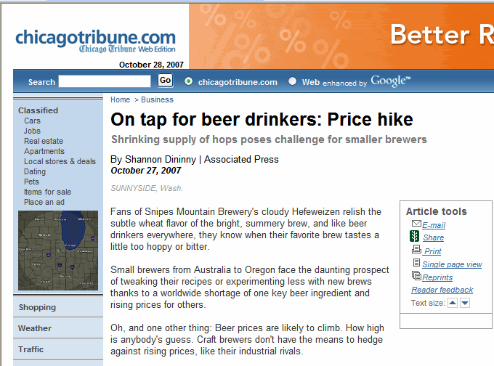

Slide 33
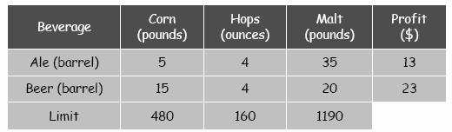
Raw Material Constraints
How do we algebraically express these constraints?
Corn: 5A + 15B <= 480
Hops: 4A + 4B <= 160
Malt: 35A + 20B <= 1190
Sources: Robert Sedgewick and Kevin Wayne, Intro slides from Vladlen Koltun.
The Allocation of Resources by Linear Programming. Scientific American, R. Bland

Slide 34
Geometry of the Constraints
What does the X-Y Plane represent?
4A + 4B = 160

Slide 35
Geometry of the Constraints: Feasible Points
4A + 4B = 160
2
1

Slide 36
All Raw Material Constraints
35A + 20B = 1190
5A + 15B = 480

Slide 37
All Raw Material Constraints: Feasible Points
2
4
3
1

Slide 38
All Raw Material Constraints: Feasible Region
Note, different constraints make up different parts of the boundary.
Now we need to add profit.

Slide 39
How much Ale and Beer do we make?
What is equation for the profit?
13A + 23B = Profit

Slide 40
Geometric View for Making a Profit Of $442

Slide 41
More Profit Curves

Slide 42
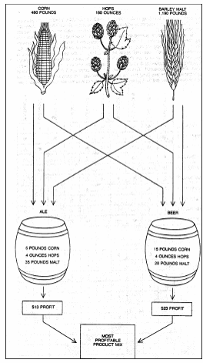
Formal Mathematical Model of the Brewery Problem
Maximize: 13A + 23B
Subject To: 5A + 15B <= 480
4A + 4B <= 160
35A + 20B <= 1190
A , B >= 0
Sources: Robert Sedgewick and Kevin Wayne, Intro slides from Vladlen Koltun.
The Allocation of Resources by Linear Programming. Scientific American, R. Bland

Slide 43
Linear Programming Terms
Objective Function (Objective or Target)
Maximize: 13A + 23B
Subject To: 5A + 15B <= 480
4A + 4B <= 160
35A + 20B <= 1190
A , B >= 0
Constraints
(Limits)
Decision Variable
(Choices)
Note, everything is linear
Sources: Robert Sedgewick and Kevin Wayne, Intro slides from Vladlen Koltun.
The Allocation of Resources by Linear Programming. Scientific American, R. Bland

Slide 44
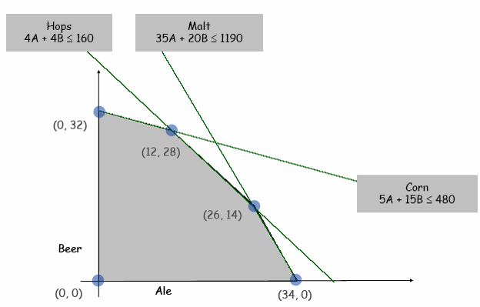
Feasible Region of Brewery Problem
Sources: Robert Sedgewick and Kevin Wayne, Intro slides from Vladlen Koltun.
The Allocation of Resources by Linear Programming. Scientific American, R. Bland

Slide 45
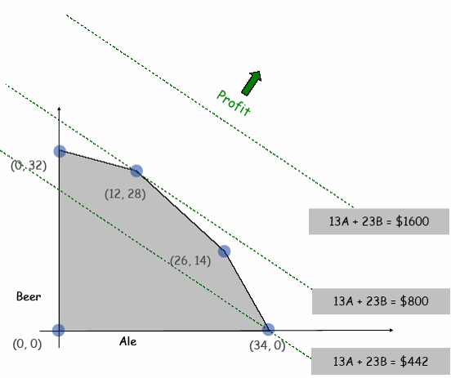
Note that the Maximum Profit Occurs at an “Extreme Point” (a Corner)
Sources: Robert Sedgewick and Kevin Wayne, Intro slides from Vladlen Koltun.
The Allocation of Resources by Linear Programming. Scientific American, R. Bland

Slide 46
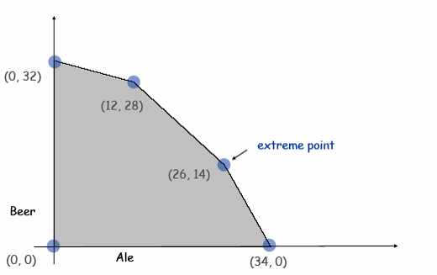
Extreme Points
Note: No matter what the objective function, an optimal solution occurs at an extreme point (can it occur at multiple extreme points?)
Sources: Robert Sedgewick and Kevin Wayne, Intro slides from Vladlen Koltun.
The Allocation of Resources by Linear Programming. Scientific American, R. Bland

Slide 47
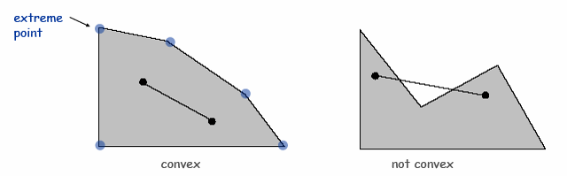
Structure of Linear Programs
Each constraint (an inequality) creates a halfplane (2D) or a hyperplane (kD)
Set of constraints creates a convex polygon (2D) or convex polytope (kD)
Convex Set: if points a and b are in the convex region, so is ½ (a + b)
Extreme Point: a point that can’t be written as ½ (a + b), where a and b are two distinct points in the set
Sources: Robert Sedgewick and Kevin Wayne, Intro slides from Vladlen Koltun.
The Allocation of Resources by Linear Programming. Scientific American, R. Bland

Slide 48
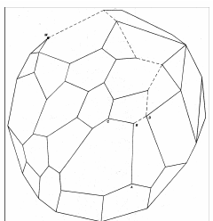
Solving Linear Programs
Extreme Point Property: If there exists an optimal solution to the linear program, then it exists at an extreme point
Insight: Only need to consider a finite number of possible solutions
Problem: The number of extreme points can grow exponentially with the size of the problem.
Simplex Method: because of the extreme point property and convexity, the simplex method is an effective procedure for finding a starting point and moving from one extreme point to another until it can prove that is has found the optimal solution.
In practice, the simplex method is very effective.
Sources: Robert Sedgewick and Kevin Wayne, Intro slides from Vladlen Koltun.
The Allocation of Resources by Linear Programming. Scientific American, R. Bland

Slide 49
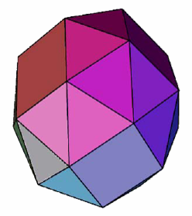
Simplex Method In Action
Sources: Robert Sedgewick and Kevin Wayne, Intro slides from Vladlen Koltun.
The Allocation of Resources by Linear Programming. Scientific American, R. Bland

Slide 50
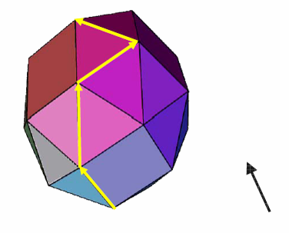
Simplex Method In Action
This is all we will cover of Simplex!
“…knowledge of algorithms is no longer necessary if practical use is to be made of mathematical programming.”
Value of the objective
Now, Let’s go to Excel to see how to solve the Beer Problem….
Sources: Robert Sedgewick and Kevin Wayne, Intro slides from Vladlen Koltun.
The Allocation of Resources by Linear Programming. Scientific American, R. Bland

Slide 51
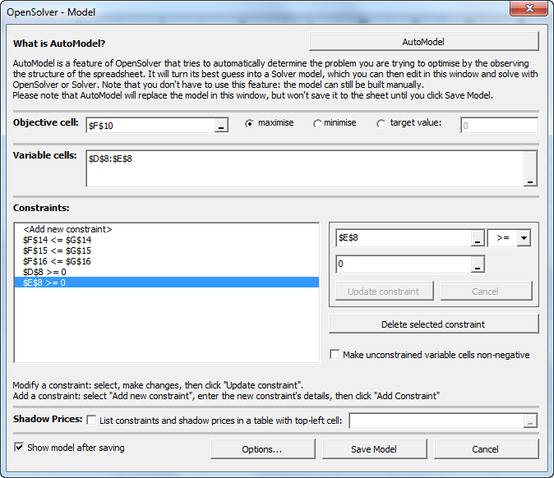
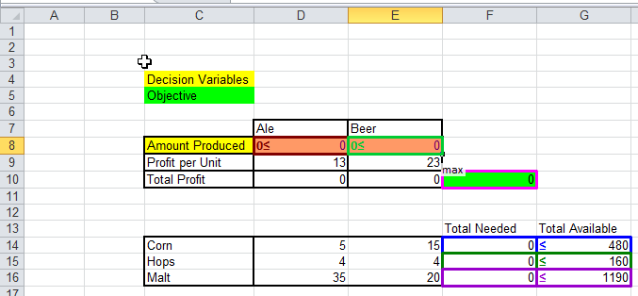
Solving Linear Programs in Excel Using OpenSolver

Slide 52
Formulating Linear Programming Models
Basic Steps: Specify
Objective: first give verbal statement of what is to be maximized or minimized, then quantify.
Constraints: what limits objective from being infinitely good? Specify qualitatively first, then quantify.
Decision Variables: what can be changed to improve objective.
Notes:
specification process may be iterative
depending on problem, the “trick” can be in any of these steps

Slide 53
Homework Preview
A good way to learn linear programming is to do it. If you’ve done it before, you can still get insight from these models. For each of the problems,
build the model in Excel or Python
solve with OpenSolver or Gurobi
make sure you understand the model,
make sure you can explain the answer,
and convince yourself that you have the right answer.
I will pick one group to present the answer to the class. You should be able to explain the model and answer questions about it.
technical (about the model),
business related (how would a business person think about the model),
or data related (why do you think the answer was 3?).

Slide 54
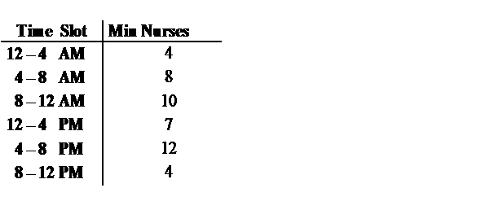
Shift Scheduling Model
Coverage Requirement:
Verbal Description:
Objective: Minimize total number of nurses scheduled per day.
Constraints: Eight hour shifts.
Decision Variables: This is the key modeling step in this problem.

Slide 55
Blending Model
Objective: Maximize daily profit
Decision Variables: How many barrels of raw gasoline type i to (purchase and) use to make fuel type j and how many barrels of raw gasoline type i to (purchase and) resell on the market Note: Blending problems always use double scripted variables like because we need to keep track of the mix of inputs (i) used to make output (j) to see if mix constraints are satisfied.
Constraints:
- Limits on availability of raw gasoline types.
- Minimum or Maximum demand for fuels
- Minimum octane rating for fuels

Slide 56
Blending Model – Data

Slide 57
Blending Model – Special Constraints
Blending Constraints: Constraint that the octane rating for fuel type 1 be at least 95 can be written:
:
But, this is not linear!

Slide 58
Cutting Stock Model
Formulation:
Objective: Fill specified set of orders with as few 20 ft. rolls as possible.
Constraints: - Demand must be satisfied - Cuts must come from 20 ft. rolls
Decision Variables: Key to cutting stock problem is defining decision variables. Consider a specific problem in which there are 3 orders to fill:

Slide 59
End of Section

